Slide 1
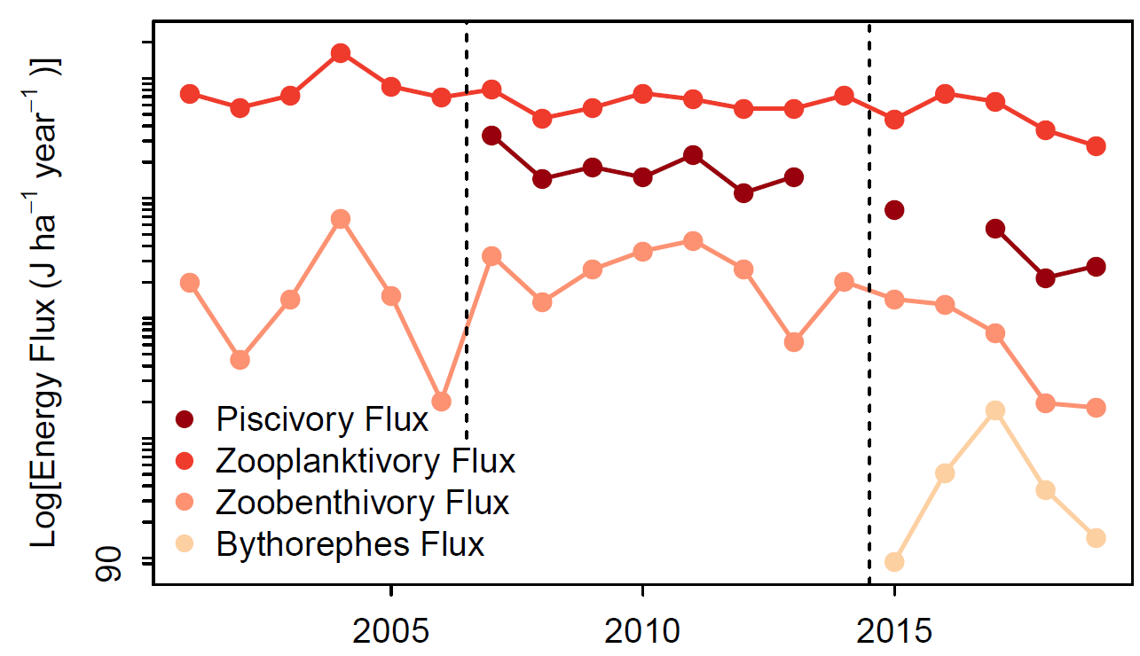
Binary matrix

Slide 2
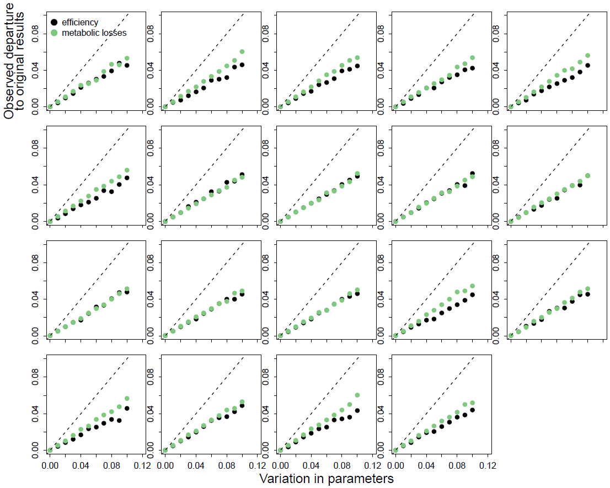
Binary food web matrix

Slide 3
2001 - 2014
cisco | lake.trout | walleye | chaoborus.larvae | leptodora | mysis | cladocera | copepoda | rotifera
0 | 0.9 | 1 | 0 | 0 | 0 | 0 | 0 | 0
0 | 0 | 0 | 0 | 0 | 0 | 0 | 0 | 0
0 | 0 | 0 | 0 | 0 | 0 | 0 | 0 | 0
0.03 | 0.06 | 0 | 0 | 0 | 0 | 0 | 0 | 0
0.04 | 0.01 | 0 | 0 | 0 | 0 | 0 | 0 | 0
0.03 | 0.03 | 0 | 0 | 0 | 0 | 0 | 0 | 0
0.4 | 0 | 0 | 0.5 | 0.5 | 0.4 | 0 | 0 | 0
0.4 | 0 | 0 | 0.5 | 0 | 0.3 | 0 | 0 | 0
0.1 | 0 | 0 | 0 | 0.5 | 0.3 | 0 | 0 | 0
2015 - 2019
cisco | lake.trout | walleye | bythotrephes | chaoborus.larvae | leptodora | mysis | cladocera | copepoda | rotifera
0 | 0.9 | 1 | 0 | 0 | 0 | 0 | 0 | 0 | 0
0 | 0 | 0 | 0 | 0 | 0 | 0 | 0 | 0 | 0
0 | 0 | 0 | 0 | 0 | 0 | 0 | 0 | 0 | 0
0.1 | 0 | 0 | 0 | 0 | 0 | 0 | 0 | 0 | 0
0.02 | 0.06 | 0 | 0 | 0 | 0 | 0 | 0 | 0 | 0
0.03 | 0.01 | 0 | 0 | 0 | 0 | 0 | 0 | 0 | 0
0.02 | 0.03 | 0 | 0 | 0 | 0 | 0 | 0 | 0 | 0
0.4 | 0 | 0 | 0.5 | 0.5 | 0.5 | 0.4 | 0 | 0 | 0
0.4 | 0 | 0 | 0.5 | 0.5 | 0 | 0.3 | 0 | 0 | 0
0.03 | 0 | 0 | 0 | 0 | 0.5 | 0.3 | 0 | 0 | 0

Slide 4
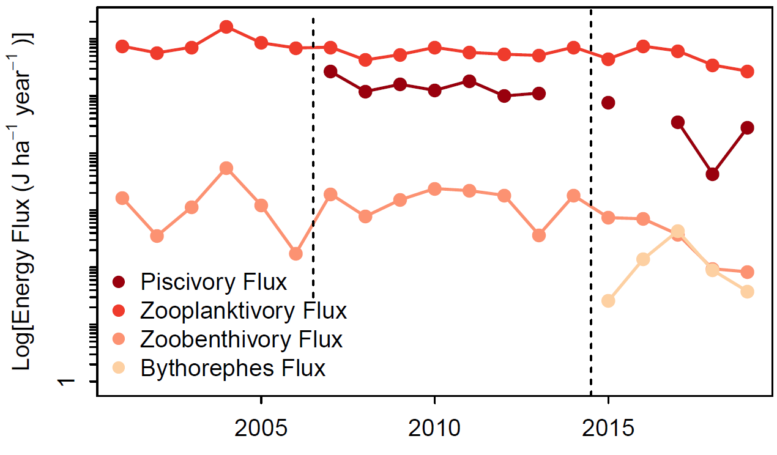
Preference matrix

Slide 5
Binary matrix

Slide 6
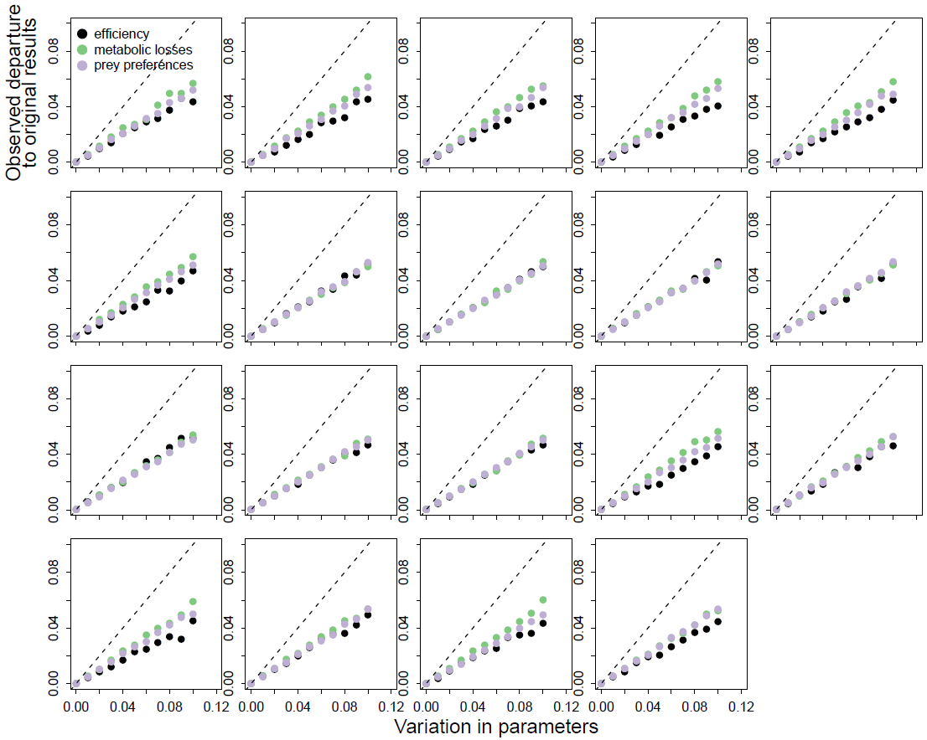
Preference food web matrix

Slide 7
Binary food web matrix

Slide 8
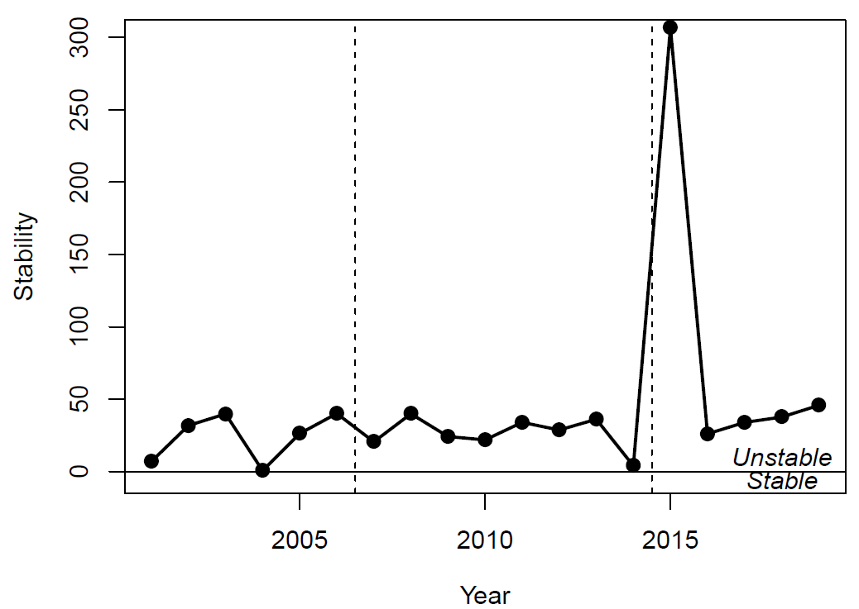
Binary matrix

Slide 9
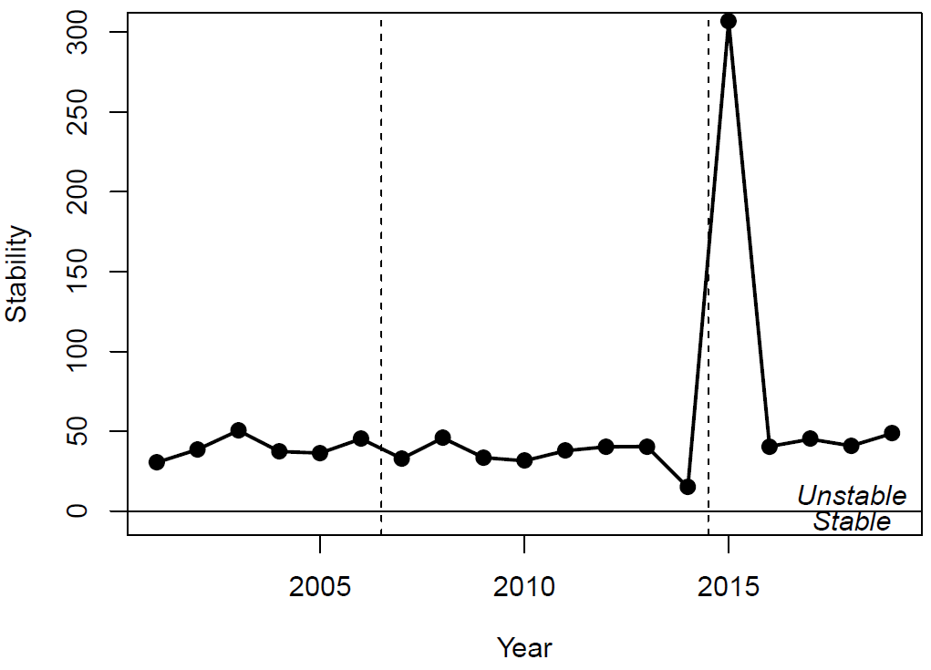
Preference matrix

